Slide 1
ANALYSIS OF RAINFALL IN INDIA IN 2022

Slide 2

AGENDA
ABSTRACT
INTRODUCTION
SYSTEM REQUIREMENTS
DATA COLLECTION AND LIBRARIES USED
DATA PREPROCESSING AND TRANSFORMATION
DATA VISUALISATION
ANALYSIS OF THE DATA
CONCLUSION
REFERENCES

Slide 3
ABSTRACT
This analysis of rainfall aims to analyze the rainfall patterns across India during the year 2022 to gain insights such as how it varies in different regions and overall
Rainfall data from various meteorological sources and government agencies were collected and analyzed.
It helps identify areas where there was more rain than usual (surplus) and places where there was less rain than expected (deficit).
This analysis emphasize the importance of how crucial is rainfall for developing strategies to manage water resources, agriculture, and infrastructure effectively, ensuring the well-being of people and the environment in the face of unpredictable rainfall and weather events.
INTRODUCTION

Slide 4
INTRODUCTION
India's diverse climate and monsoon-driven precipitation play a crucial role in its agricultural and economic sectors.
Understanding rainfall patterns is vital for effective water resource management and climate adaptation strategies.
This study analyzes meteorological data from various sources to reveal the spatial and temporal distribution of rainfall across India during 2022.
Identifying regions with surplus and deficit precipitation will provide valuable insights for informed decision-making and sustainable development in the face of changing weather patterns.

Slide 5
SYSTEM REQUIREMENTS
Hardware Requirements:
Processor: Intel Core i5 or equivalent AMD processor for better performance.
Storage: At least 10 GB of free space
RAM:4GB / above
Software Requirements:
Operating System: Windows, macOS, or Linux
Python: Version 3.6 or higher
Integrated Development Environment (IDE): Any IDEs like Jupyter Notebook, Visual Studio code, etc.,
Python Libraries: Install the necessary Libraries which are pandas, NumPy, matplotlib, seaborn, calendar

Slide 6

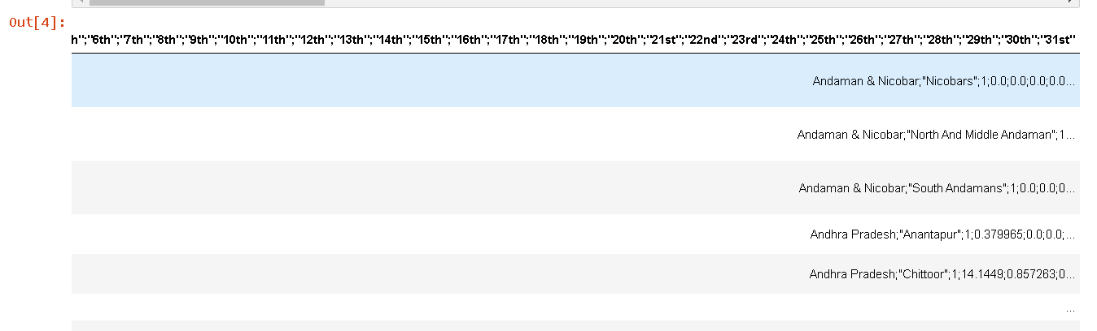
Data Collection and Description
The data is collected from the Kaggle website, which is opensource dataset provider. The link to the dataset is Indian Rainfall Dataset District-wise Daily Measurements (Ctrl+Click, to visit the website)
Data was collected from India Meteorological Department(IMD) records. The IMD collects rainfall data using a network of rain gauges installed throughout the country. The data is recorded manually or automatically and used for weather forecasts, climate monitoring, and other applications.
The data is in the CSV format and the size of the data file is about 1.8 MB.
This dataset provides comprehensive monthly rainfall data for various districts in India. It includes information on the amount of rainfall recorded each day from the 1st to the 31st of the month, allowing for a detailed analysis of precipitation patterns across different districts in India. The dataset contains 34 columns, including state, district, month, and daily rainfall measurements (in millimeters) for each specific day of the month.
The data don’t have any null values or duplicated values as the IMD collects every district data perfectly.

Slide 7
Libraries and Tools Used for Analysis of the Data
Pandas: Python library for data manipulation and analysis with DataFrames and Series. Here we used pandas to read the csv file of data and converted that into structured dataset with well defined features.
Calendar: Python module for working with dates and calendars. In this project we used Calendar Library to convert the month number into usual month names.
Matplotlib.pyplot: Python plotting library for creating various types of plots.
Seaborn: Python data visualization library with higher-level functions for statistical graphics.

Slide 8
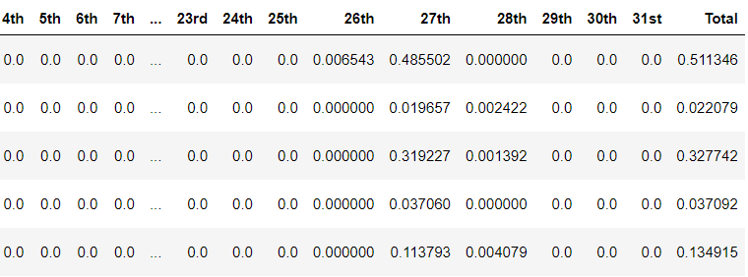
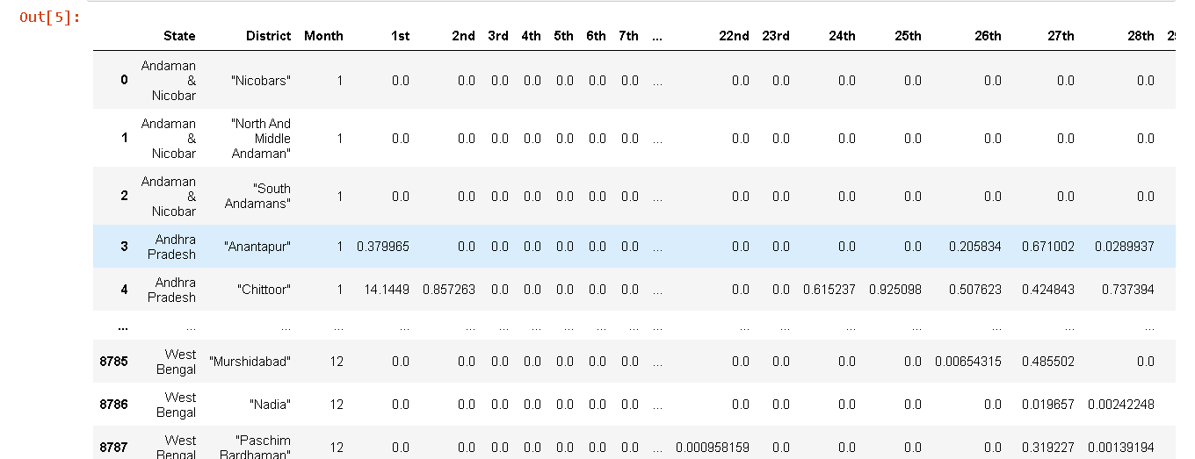
DATA PREPROCESSING
Obtained raw data from Kaggle in CSV format, comprising a single column containing a lengthy string.
The data from a single string format is converted into a structured table with multiple columns for further analysis.
By splitting the string at semicolons, new columns were generated, each containing distinct information.

Slide 9
DATA TRANSFORMATION
Transformed the data into a structured table format with multiple columns.
Adding up the rainfall data from 1st to 31st of every month of individual district and storing that information in another feature which is named as Total for in-depth analysis of rainfall trends.

Slide 10
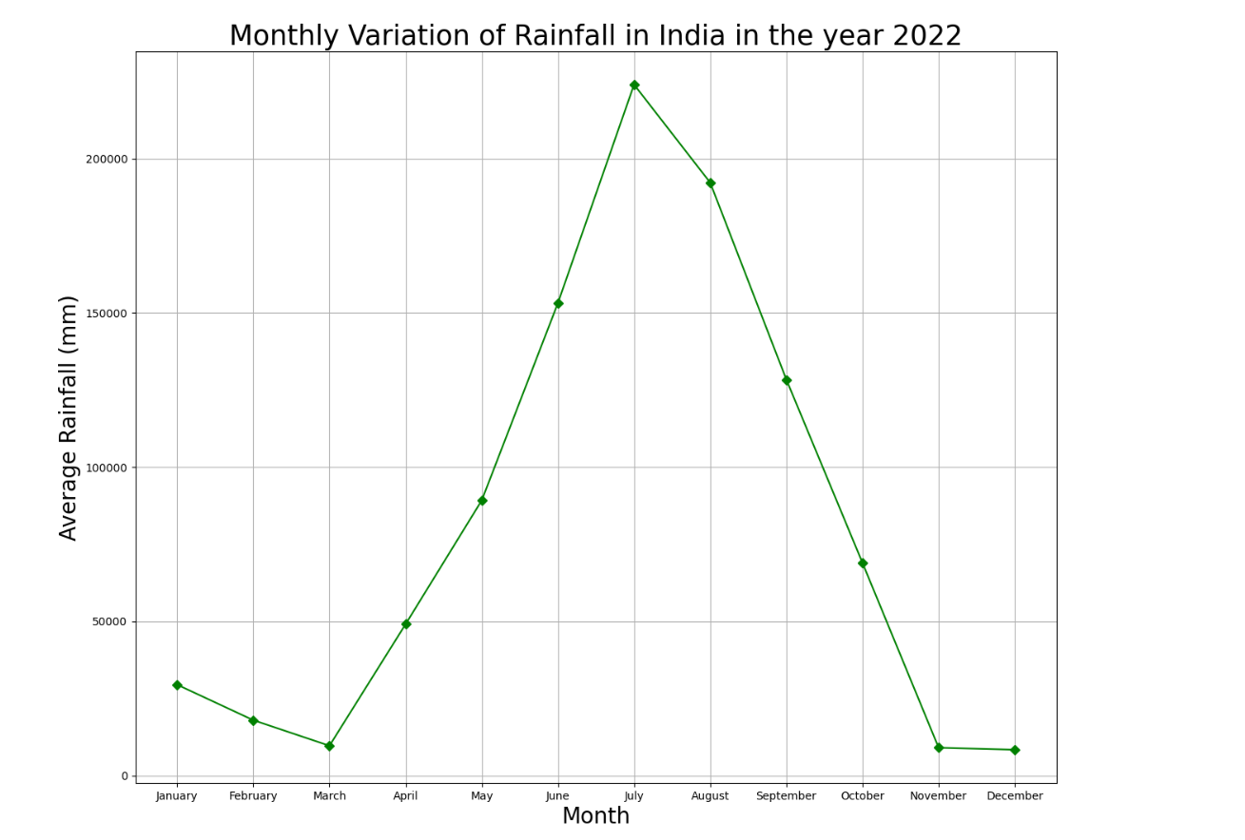
DATA VISUALIZATION
- Let's explore the data and visualize to understand it in better for further analysis.
- Initially, we'll observe the total monthly rainfall to identify trends over time.
- Next, we'll create a geospatial visualization to see the average monthly rainfall for each state and district in India and understand their patterns.
- To extract insights from the data, we'll group it by state and month and use basic visualization methods like bar plots and heatmaps.
- Bar plots will show us how rainfall varies across different states, while heatmaps will help us compare rainfall data between states and months.

Slide 11
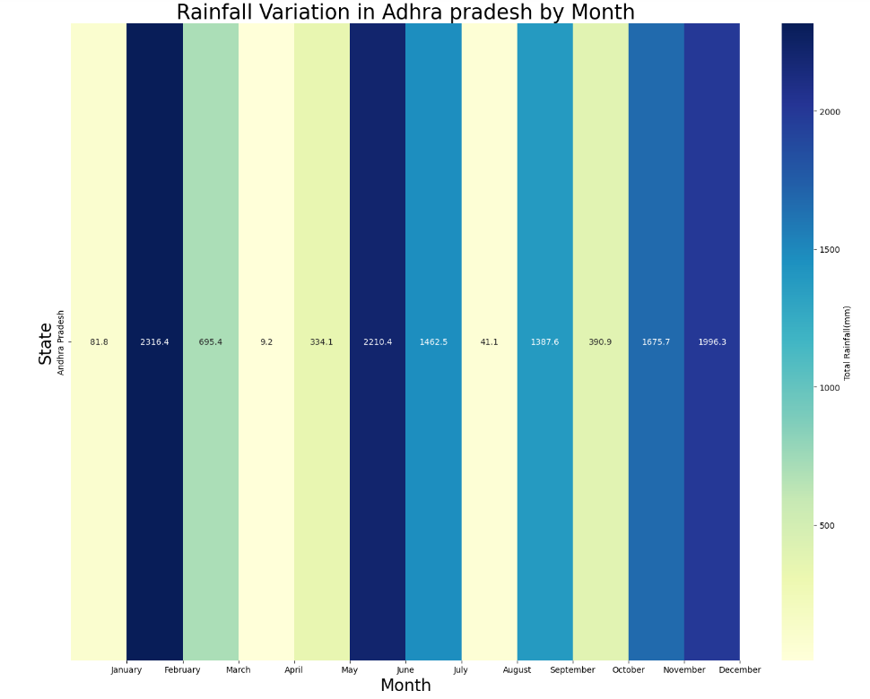
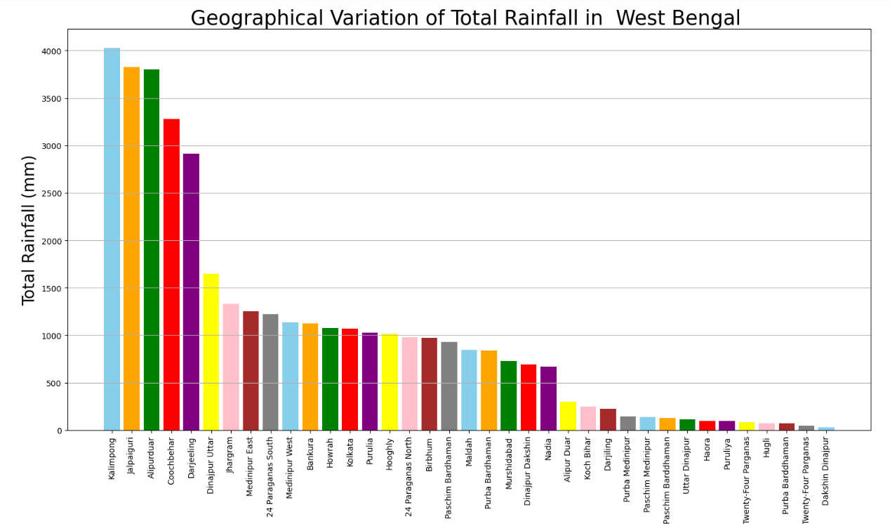
State-District
State – Month
Above line plot is Monthly Variation of Rainfall in India in the year 2022 , we can say that in the months June, July and August the rainfall is highest. And in the months March, November and December the rainfall is lowest in the India in the year 2022.

Slide 12
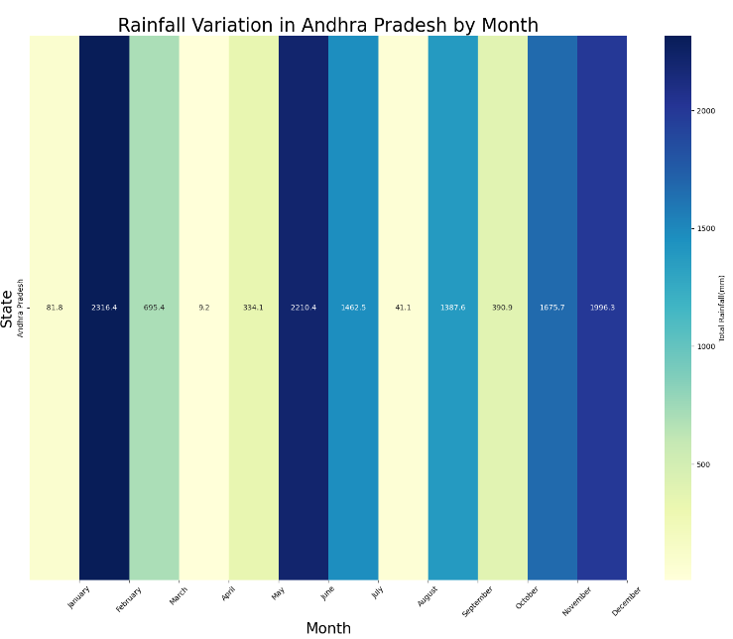
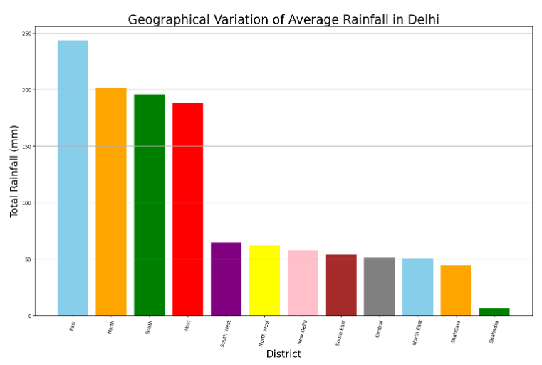
State – Month Heatmap Variation
State-District Variation

Slide 13
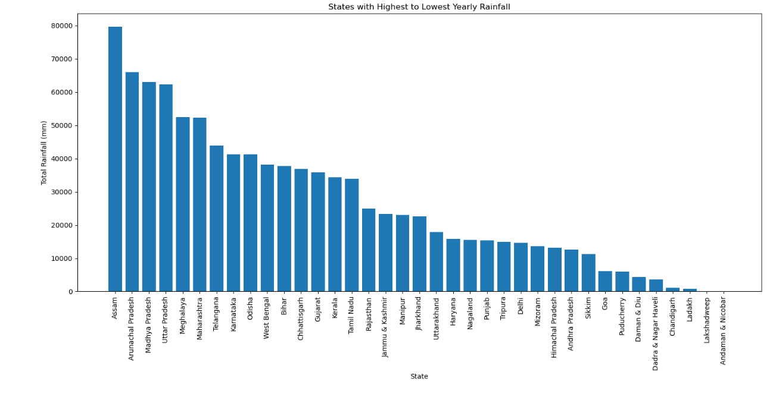
OVER-VIEW ANALYSIS OF THE DATA
AVERAGE MONTHLY RAINFALL OF EVERY STATE FROM HIGHEST TO LOWEST

Slide 14
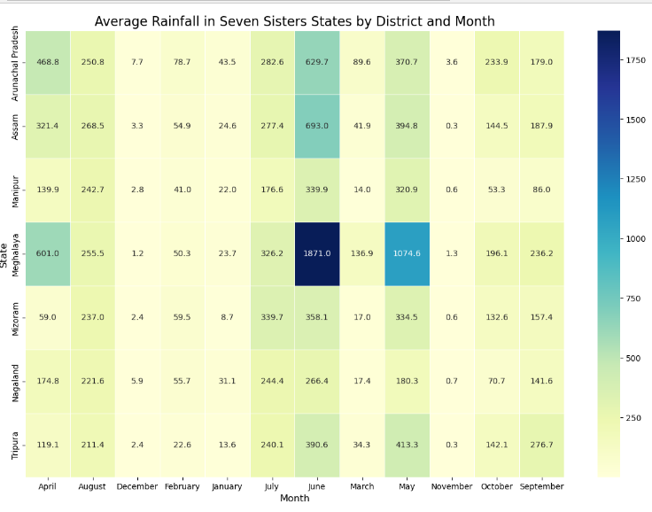
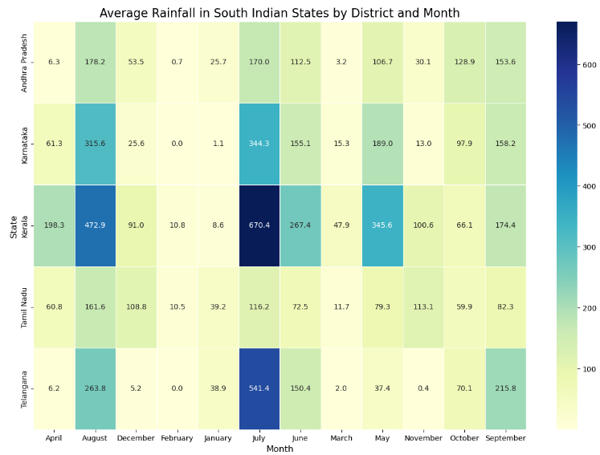
Based on above heatmaps we can see that seven sisters states which are North-eastern States are having relatively higher rainfall than other states of India, up next we have South Indian states which are basically coastal region states receiving more rainfall than north Indian States which are Punjab, Haryana, Uttar Pradesh, etc.,. And among the seven sisters Meghalaya receiving higher rainfall than other states of India and From south India Kerala receiving high rainfall.

Slide 15
The key insights after visualizing the data
Assam had the highest total rainfall, while Andaman & Nicobar had the lowest with minimal rainfall.
Highest rainfall observed during June, July, and August in India for the year 2022.
Lowest rainfall recorded in March, November, and December during the same year.
Geographical variation of rainfall depicted through plots for all states and districts.
Meghalaya experienced the highest average monthly rainfall, while Andaman & Nicobar and Lakshadweep had the lowest total rainfall, almost negligible.
CONCLUSION
India's diverse climate patterns highlighted by the variation in rainfall across different states.

Slide 16
CONCLUSION
The project successfully analyzed the rainfall patterns in India during the year 2022 to gain insights into seasonal variations.
Using statistical tools and software, the team processed the data, calculating monthly averages and creating visualizations to present the findings effectively.
The first quarter of the year showed a significant increase in rainfall, providing early-season agricultural advantages.
However, the mid-year period, specifically June and July, experienced an unexpected dip in rainfall, potentially impacting crop growth and water reservoir levels.
Our project shows how analyzing rainfall data helps us understand the weather in our area better. The insights we gained can be valuable for people who make decisions about water resources and preparing for different weather conditions caused by climate changes.

Slide 17


REFERENCES
https://www.kaggle.com/ website to find the rainfall datasets and the basic information about the dataset.
https://mausam.imd.gov.in/ website to know about how the data of rainfall of every district of India is recorded.

Slide 18
THANK
YOU

